Slide 1
Architectural Patterns and Design Tactics

Slide 2
First, let’s take a step back
Architecturally Significant Requirement (ASR): A requirement that will have a profound effect on the architecture – that is the architecture may be significantly different in the absence of this requirement.
ASRs, often, but not always, take the form of quality attributes requirements – the performance, security, modifiability, availability, usability, that the architect must provide the system.
Quality Attribute: A measurable or testable property of a system that is used to indicate how well the system satisfies the needs of its stakeholders.

Slide 3
Quality Attributes – Master List
Operational categories
  Availability
  Interoperability
  Reliability
  Usability
  Performance
  Deployability
  Scalability
  Monitorability
  Mobility
  Compatibility
  Security
  Safety
Developmental categories
  Modifiability
  Variability
  Supportability
  Testability
  Maintainability
  Portability
  Localizability
  Development distributability
  Buildability

Slide 4
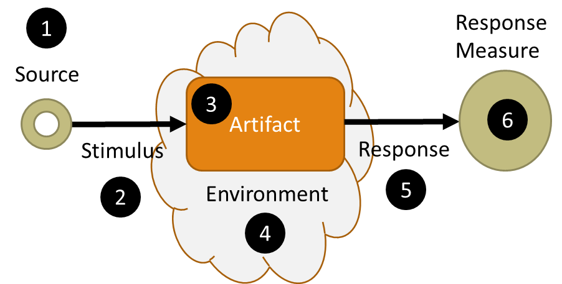
Quality Attribute Scenario
A means of specifying quality attributes requirements
1) The source of the stimulus
2) The stimulus, an event,
user operation, attack, etc.
3) The target of the stimulus
4) The set of circumstances in which the scenario takes place
5) The activity that occurs as the result of the stimulus
6) A measurement of the response

Slide 5
Achieving Quality Attributes
Two general approaches:
  Design Tactics
  Architectural Patterns
  Each of these represents a decision – system designs (architectures) are a collection of decisions

Slide 6
Availability
A software component is there and ready to carry out its task when needed

Slide 7
Points to Consider
  Availability builds on the concept of Reliability by adding Recovery
    Robustness
    Failure is not an option
  Fault Detection
  Fault Handling
    Mask
    Repair Faults

Slide 8

Measuring Availability
    $$MTBF/(MTBF+ MTTR)$$
    MTBF – Mean Time Between Failures
    MTTR – Mean Time to Repair
Availability | Downtime / 90 days | Downtime / Year
99.0% | 21 hrs, 36 min | 3 days, 15.6 hrs
99.9% | 2 hrs, 10 min | 8 hrs, 0 min, 46 sec
99.99% | 12 min, 58 sec | 52 min, 34 sec
99.999% | 1 min, 18 sec | 5 min, 15 sec
99.9999% | 8 sec | 32 sec
Notes:
Six Sigma = 0.00034% -- Six standard deviations from the mean – or in our example, only 26 seconds every 90 days

Slide 9
Example: Availability
The system will be available 99.0% of the time
When a fault occurs the
module needs to recover
in 1 minute.
1) Internal or External Failure
2) Fault
3) The target of the stimulus
4) Normal runtime environment
5) Fault corrected / Module returned to operation
6) Time from detection to resolution

Slide 10
Design Tactics
  Provide a way of making design and analysis more systematic
  Provide a systematic means for augmenting an existing pattern
  If no pattern exists, tactics allow constructing a design fragment from “first principles”
Tactics to Control Response
Change
Arrives
Changes made within time and budget
Modifiability Tactic

Slide 11
Example:
The System will be available 99.0% of the time.
Availability Tactics keep faults from becoming failures or bound the effects of the fault and make repair possible.
  Availability:
To achieve our availability requirements we need to detect faults within 1 second of occurrence and address them within 59 seconds.
Tactics to Control Response
Fault
Fault masked, prevented, or repair made

Slide 12
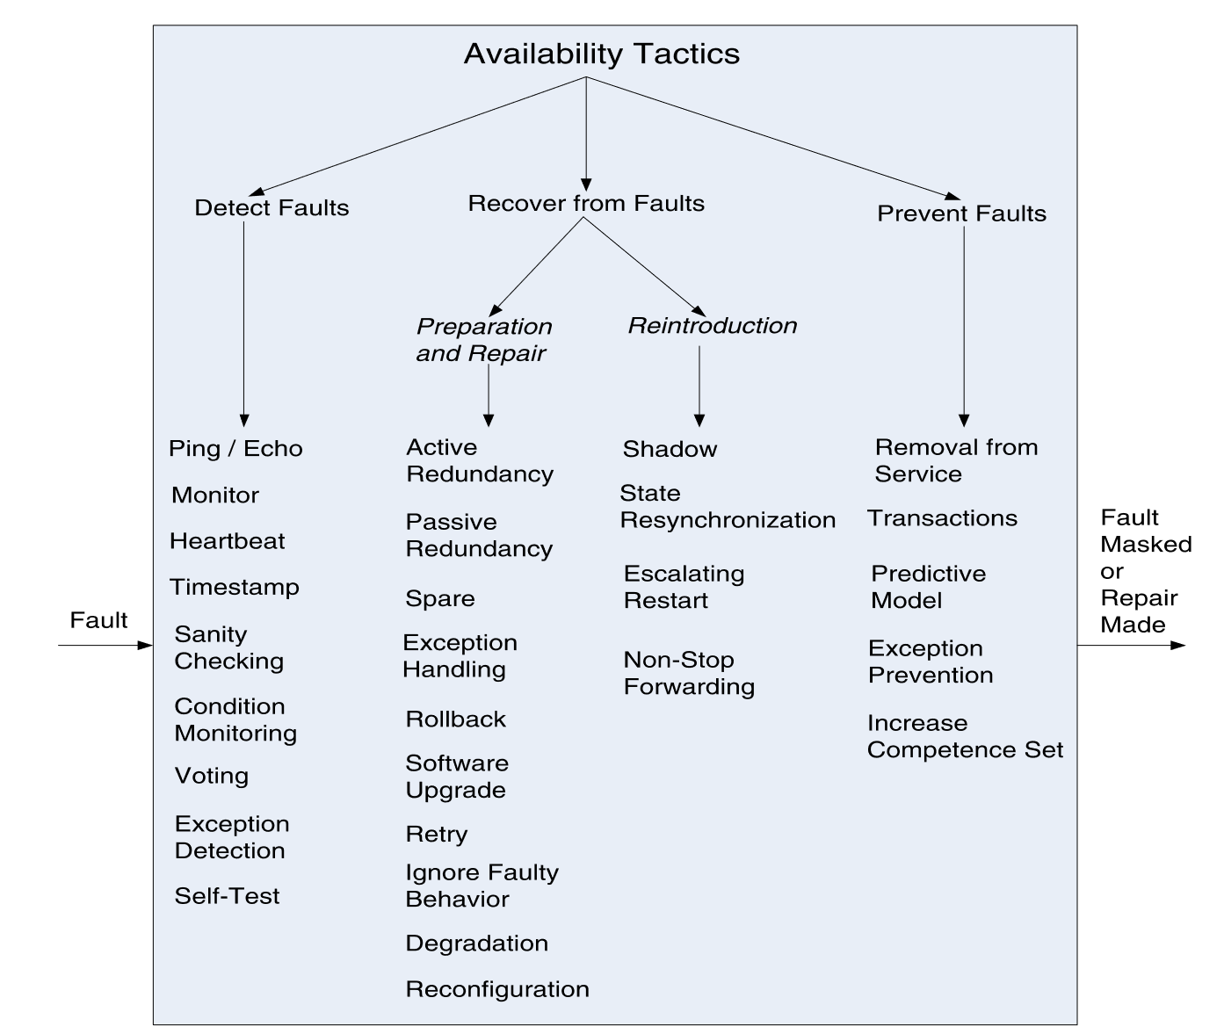
Tactics for Availability
The application of a tactic depends on the context

Slide 13
Detect Faults
Monitor: A component is used to monitor the health of various other parts of the system. It orchestrates software using other tactics to detect malfunctioning components
Ping / Echo: An asynchronous request / response message pair is exchanged between nodes. The echo indicates the pinged component is alive
Heartbeat: A periodic message (a heartbeat) is sent by a node notifying a listening monitor that it is still alive.
Timestamp: Used to detect incorrect sequences of events
Condition Monitoring: Check conditions in a process or device, or validating assumptions made during design
Sanity Checking: Check the validity of specific operations or outputs of a component
Voting: Comparing computational results from multiple sources
Exception Detection: Detection of a system condition that alters the normal flow of execution
Self-test: Run a set of procedures to test for correct operation

Slide 14
Recover from Faults
Preparation and Repair: A set of tactics based on a variety of combinations of retrying a computation or introducing redundancy
  Redundant Spare
  Rollback
  Exception Handling
  Software Upgrade
  Retry
  Ignore faulty behavior
  Graceful degradation
  Reconfiguration
Reintroduction: Reintroduce a failed component after its been repaired
  Shadow
  State resynchronization
  Escalating restart
  Nonstop forwarding

Slide 15
Prevent Faults
Removal from Service: temporarily place a system component in an out-of-service state for the purpose of mitigating potential system failures
Transactions: Ensure that asynchronous messages exchanged are Atomic, Consistent, Isolated and Durable
Predictive Model: Use performance metrics to predict the onset of faults
Exception Prevention: Use methods to prevents exceptions from occurring – self correcting codes
Increase Competence Set: Increase the set of states a program is ‘competent’ to operate in

Slide 16
Example:
The System will be available 99.0% of the time.
Availability:
One set of tactics we might want to consider is Fault Detection.
  Specific tactics to used would depend on the type of availability problem we are solving for
    Service is unresponsive
  Potential tactics would be:
    Ping/Echo
    Heartbeat
  Failure would result in a restart (a repair to the system)
Tactics to Control Response
Fault
Fault masked, prevented, or repair made

Slide 17
Example:
Selection of a specific design tactic then becomes a design decision, part of our architecture.
We have a requirement that a module(s) implement a specific technique (ping-echo or heartbeat).
We have a two parameters that must be satisfied:
  Time to detect the fault
  Time to recover from the fault

Slide 18
Deployability
A property of software indicating that it may be deployed – within a predictable and acceptable amount of time and effort

Slide 19
Points to Consider
  How an executable is updated
    How it is invoked
    How it is measured
    How it is monitored
    How it is controlled
  How is Software deployed
    How does it arrive at its host
    How is it integrated into an existing system
    What is the medium
    What is the packaging
    What is the resulting integration into an existing system
    What is the efficiency of executing the process
    What is the controllability of the process
  Granularity – can we deploy elements of the system or the whole system
  Controllable – the ability to deploy at varying levels of granularity
  Efficient – Rapid deployment (and rollback) with a reasonable amount of effort

Slide 20
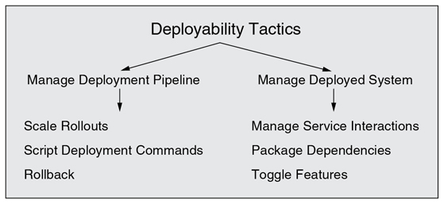
Deployability Tactics

Slide 21
Manage Deployment Pipeline
Scale Rollouts: Deploy new versions of a system to a limited user set
Script Deployment Commands: Automate the release process
Rollback: Ability to move back to a previous release with little effort

Slide 22
Manage Deployed Systems
Manage Service Interactions: Accommodate simultaneous deployment and support of multiple versions
Package Dependencies: Deploy packages with their dependencies to ensure versions are consistent

Slide 23
Patterns
Microservice
Blue / Green – new components are released and pointed to, old components are kept in reserve until validation is complete
Rolling Upgrade
Canary Testing
A|B Testing

Slide 24
Microservices Architecture Pattern
Context - deploy server based enterprise applications that support a variety of browser and native mobile clients. The application handles client requests by executing business logic, accessing a database, exchanging messages with other systems, and returning responses. The application might expose a 3rd party API.
Problem – Monolithic applications can become too large and complex for efficient support, and deployment for optimal distributed resource utilization such as in cloud environments
Solution - build applications as suites of services. Each service is independently deployable and scalable, and has its own API boundary. Different services can be written in different programming languages, manage their own database, and developed by different teams
http://martinfowler.com/articles/microservices.html

Slide 25
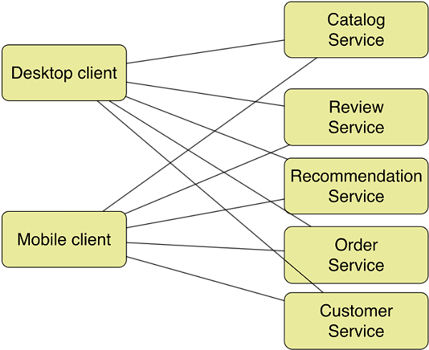
Microservices Architecture Pattern Example
Used by Amazon and Netflix

Slide 26
Microservices Architecture Pattern Solution
Overview – decompose business logic into a series of independently developed and deployable services
Elements – services are packaged as out-of-process components with well defined service boundaries (APIs). They can be implemented in any programming language. They may manage their own database as part of the service boundary.
Relationships – clients invoke services via simple remote procedure calls/web services using for example HTTP RESTful interfaces, or using a lightweight message bus.
Constraints – complexity of distributed systems. Decentralized data management is harder to manage such as support for cross service transactions. Development team experience to make good service decomposition decisions, testing and deployment know how
Weaknesses – systems must be designed to tolerate service failures which requires more system monitoring. Service choreography and event collaboration overhead. More memory

Slide 27
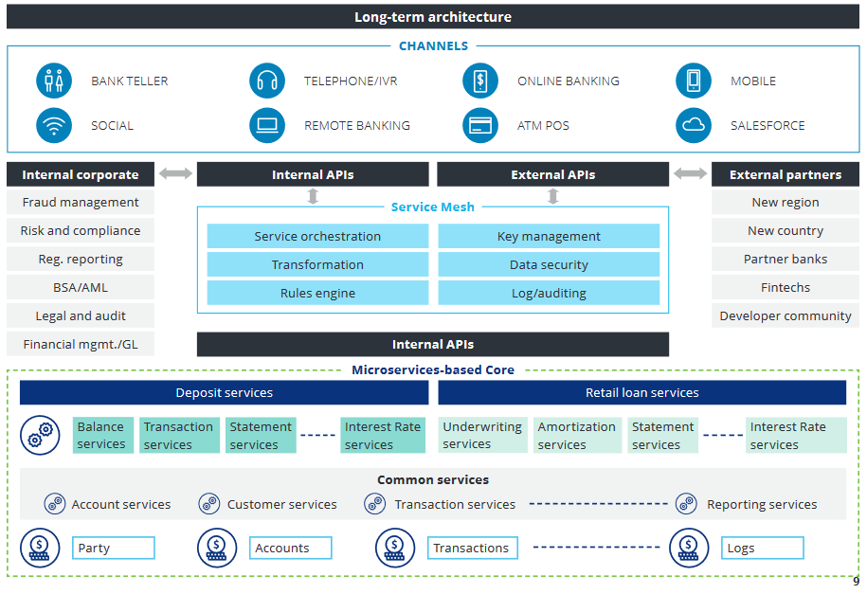
https://www2.deloitte.com/content/dam/Deloitte/us/Documents/financial-services/us-enabling-platform-banking-pov.pdf

Slide 28
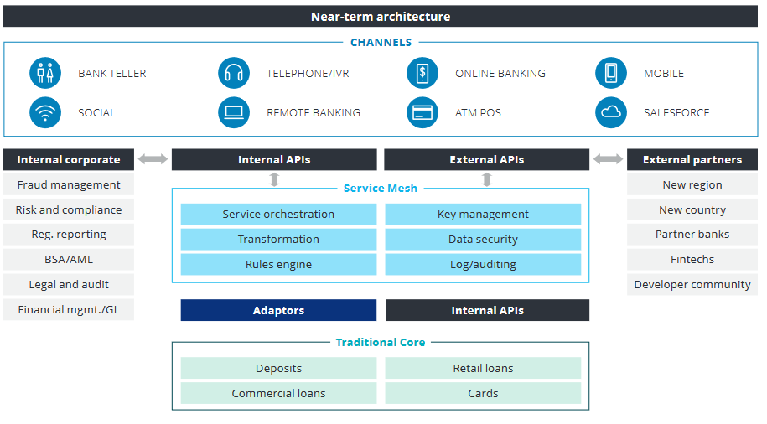

Slide 29
Energy Efficiency

Slide 30
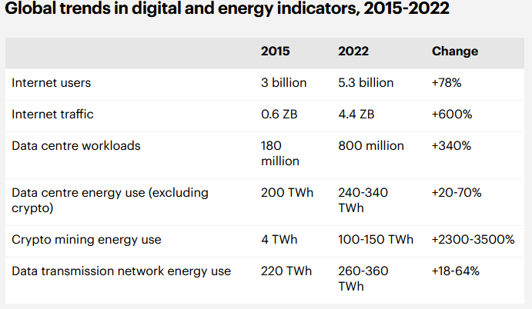
Points to Consider
  If system-wide techniques for monitoring and managing energy are lacking, then developers are left to invent their own
  Energy efficiency must be balanced with performance and availability
  Global data centre electricity use in 2022 was 240-340 TWh, or around 1-1.3% of global final electricity demand¹
    This reflects a moderation in demand driven by improved
    hardware and efficiencies in large data centers
    This excludes cryptocurrency mining which adds 110 TWh
    or another .4% of global energy demand
    2021 Global data centre electricity usage was 220-320 TWh
1. https://www.iea.org/reports/data-centres-and-data-transmission-networks
Notes:
The growing energy footprint of artificial intelligence https://www.cell.com/joule/fulltext/S2542-4351(23)00365-3
Google: 2021 electricity usage: 18.3 TWh
Estimated amount of electricity used by Generative AI in 2027: 85.4–134.0 TWh

Slide 31
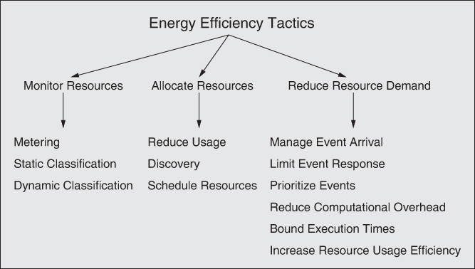
Energy Efficiency Tactics

Slide 32
Monitor Resources
Metering: Collection information about energy consumption of computation resources using a sensor network
Static Classification: Estimate energy usage by cataloging the computing resources used and their known energy characteristics
Dynamic Classification: Estimate energy consumption based on knowledge of transient conditions

Slide 33
Allocate Resources
Reduce Usage: Reduce device specific activities, removing or deactivating unused resources, reduce screen refresh rates
Discovery: Enhance discovery techniques to consider energy usage / efficiency when selecting a provider
Schedule Resources: Use scheduling to effectively manage energy usage

Slide 34
Reduce Resource Demand
Manage Event Arrival: Reduce the number of events, sample incoming events
Limit Event Response: Set a maximum rate for event processing
Prioritize Events: Delay or batch processing unimportant events
Reduce Computational Overhead: Co-locate services to consolidate usage and minimize energy spent on communication
Bound Execution Times: Limit time spent processing events
Increase Resource Usage Efficiency: Improve algorithm performance, reduce accessing external resources, replace resources with energy efficient models

Slide 35
Modifiability
Modifiability is all about change and how to lower the cost of making changes

Slide 36
Points to consider:
  What can change
  What is the likelihood of change
  When is the change made and who makes it
  What is the cost of change

Slide 37
Types of Modifiability
Scalability – increasing the amount of resources.
  Need to consider effectiveness of added resources
    In what situations do they add value?
Variability – the ability to support a variety of variants
  Product Families
Portability – ability to move software from one platform to another
Location Independence – the location of needed services is not known prior to runtime and/or changes during runtime

Slide 38
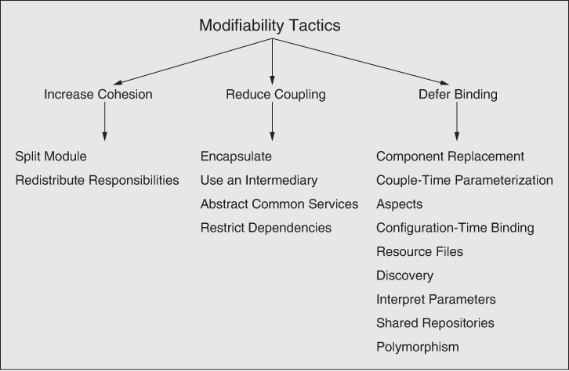
Modifiability Tactics

Slide 39
Increase Cohesion
Split Module: Refactor into cohesive modules
Redistribute Responsibilities: Group like functionality

Slide 40
Reduce Coupling
Encapsulate: Introduce an explicit interface to an element
Use an Intermediary: Add an intermediary to break dependencies between components
Abstract Common Services:
Restrict Dependencies: Restrict which modules a given module interacts with

Slide 41
Defer Binding
Component Replacement
Couple-time Parameterization
Aspects
Configuration-Time Binding
Resource Files
Discovery
Interpret Parameters
Shared Repositories
Polymorphism
Compile / Build Time
Deployment, startup or initialization Time
Run Time

Slide 42
Patterns for Modifiability
Layers Pattern – divide the system such that modules can be developed and evolved separately
Client-Server Pattern – a server supplies services to multiple distributed clients
Plug-in (Microkernal) Pattern – elements that provide a core set of functionality and specialized variants that add functionality
Publish-Subscribe Pattern – components communicate asynchronously through events. Publisher has no knowledge of subscribers, subscribers only understand the message type they’re looking for.
Pipe and Filter – systems need to transform streams of discrete data items
Broker – structure a system so services do not the nature or location of service providers
Blackboard – independent specialized programs work cooperatively utilizing a common data structure with a central controller coordinating the knowledge sources

Slide 43
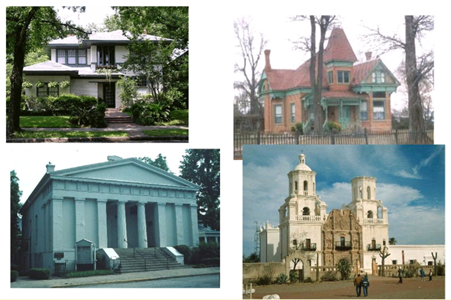
Architectural Styles (Patterns)

Slide 44

http://www.mushroomhouse.com/mushroom-house-exterior

Slide 45
Patterns – a Review
Work on software patterns stemmed from work on patterns for building architecture carried out by Christopher Alexander (A Pattern Language: Towns, Buildings, Construction (1977))
All well-structured software systems are full of patterns
  Architectural patterns – system level structural organization
  Design patterns – component level design
  Programming idioms – reoccurring constructs expressed in different languages (programming tasks, algorithms, data structures; e.g., increment counter)

Slide 46
An Architectural Pattern…
  Is a package of design decisions that is found repeatedly in practice
  Has known properties that permit reuse
  Describes a class of architectures

Slide 47
What is a Software Architectural Pattern?
A pattern is a solution to a problem in a context
  Context. A recurring, common situation in the world that gives rise to a problem.
  Problem. The problem, appropriately generalized, that arises in the given context.
  A solution. A successful architectural resolution to the problem, appropriately abstracted
An architectural pattern expresses a fundamental structural organization abstraction for software systems
  A set of structural elements
  Their relationships
  Rules and guidelines for organizing the relationships between them

Slide 48
Software Architecture Patterns
Versus software design patterns – higher level system wide in scope; some overlap
  Recall the distinction between architecture and design work
Most software systems cannot be structured according to a single architectural pattern
  Example: Design a system for flexibility of component distribution in a heterogeneous computer network and for adaptability of their user interfaces
How do you think about software design? Essentially the same cognitive process for architecture design …
  Requirements driven, separation of concerns, top-down, apply patterns

Slide 49
Describing a Pattern Solution
A pattern solution is determined and described by:
  A set of element types (for example, data repositories, processes, and objects)
  A set of interaction mechanisms or connectors (for example, method calls, events, or message bus)
  A topological layout of the components
  A set of semantic constraints covering topology, element behavior, and interaction mechanisms
  I.e., views
Organize patterns by predominant structure – module, connector, allocation

Slide 50
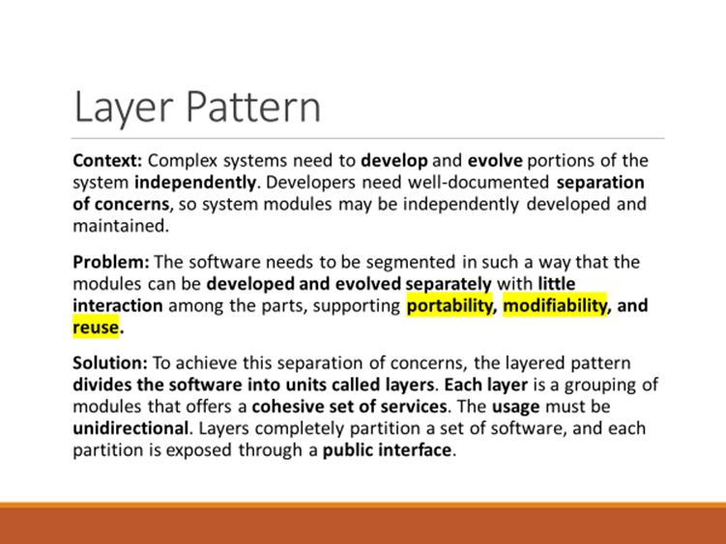
Patterns and Quality Attributes
Patterns: Packaged strategies for solving some of the problems facing a system
A pattern typically packages multiple design decisions into a single package. In other words, a packages generally address multiple Quality Attributes and ASRs.

Slide 51
Relationships Between Tactics and Patterns
A pattern is a high level structural design choice
A tactic is a lower level design decision to achieve a QA response
Patterns are built from tactics; if a pattern is a crystal, a tactic is a molecule or an atom.
For example the layered pattern utilizes the tactics:
  Increase semantic coherence
  Encapsulation
  Abstract common services
  Restrict communication paths
  Use an intermediary
All of which are methods of achieving the Quality Attribute Modifiability

Slide 52
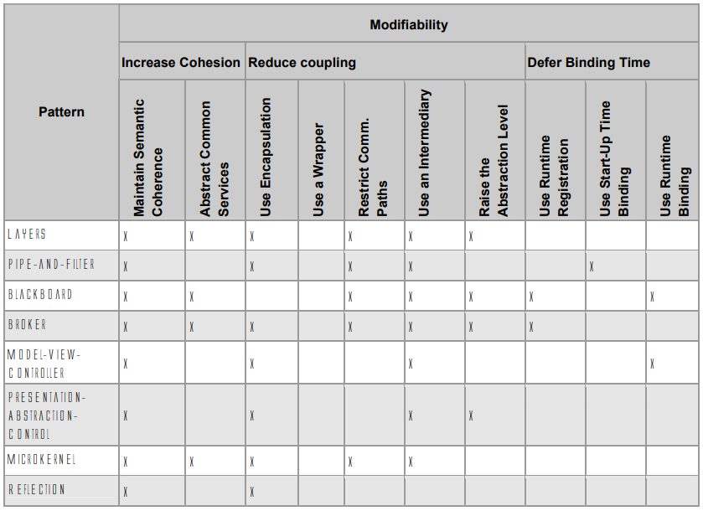
Modifiability Tactics and Patterns
SEI Technical Report: Modifiability Tactics

Slide 53
Layer Pattern
Context: Complex systems need to develop and evolve portions of the system independently. Developers need well-documented separation of concerns, so system modules may be independently developed and maintained.
Problem: The software needs to be segmented in such a way that the modules can be developed and evolved separately with little interaction among the parts, supporting portability, modifiability, and reuse.
Solution: To achieve this separation of concerns, the layered pattern divides the software into units called layers. Each layer is a grouping of modules that offers a cohesive set of services. The usage must be unidirectional. Layers completely partition a set of software, and each partition is exposed through a public interface.

Slide 54
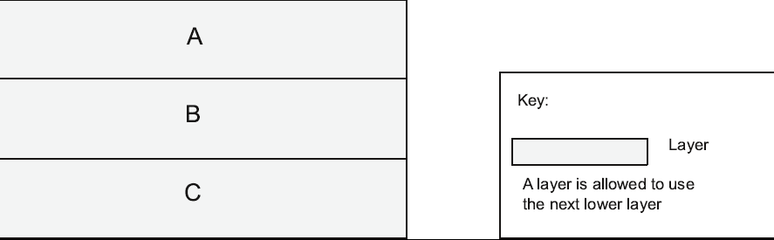
Layer Pattern Example

Slide 55
UML Package Notation for Layer Diagrams
Note: The textbook uses various informal architecture notations. That is OK if you use legends (keys) to explain the components, connectors, and structures.

Slide 56
Business IT Example
Software Architecture Patterns, Mark Richards

Slide 57
Layer Pattern Solution
Overview: The layered pattern defines layers (groupings of modules that offer a cohesive set of services) and a unidirectional allowed-to-use relation among the layers.
Elements: Layer, a kind of module. The description of a layer should define what modules the layer contains.
Relations: Allowed to use. The design should define what the layer usage rules are and any allowable exceptions.
Constraints:
  Every piece of software is allocated to exactly one layer.
  There are at least two layers (but usually there are three or more).
  The allowed-to-use relations should not be circular (i.e., a lower layer cannot use a layer above).
Weaknesses:
  The addition of layers adds up-front cost and complexity to a system.
  Layers contribute a performance penalty.

Slide 58
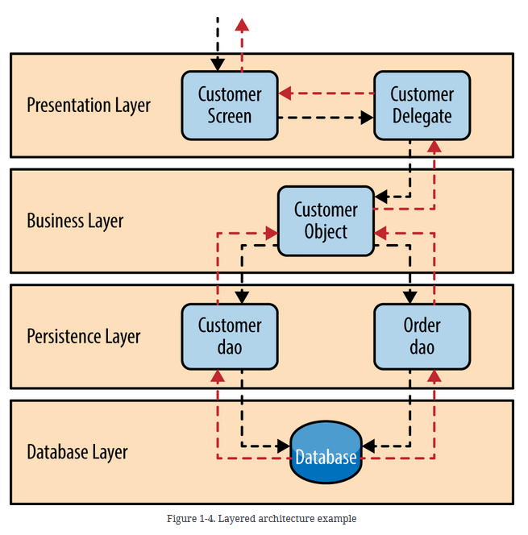
Software Architecture Patterns
by Mark Richards

Slide 59
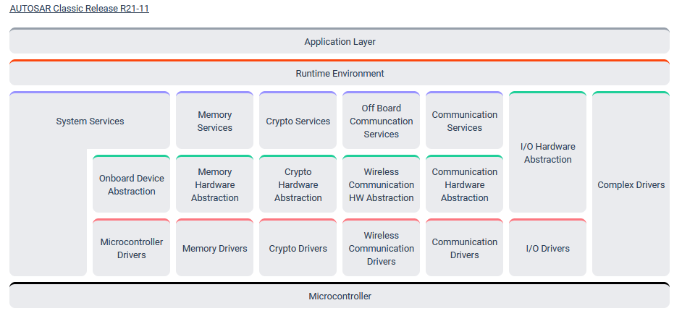
AUTOSAR Layered Architecture

Slide 60
Client-Server Pattern
Context: There are shared resources and services that large numbers of distributed clients wish to access, and for which we wish to control access or quality of service.
Problem: By managing a set of shared resources and services, we can promote modifiability and reuse, by factoring out common services and having to modify these in a single location, or a small number of locations. We want to improve scalability and availability by centralizing the control of these resources and services, while distributing the resources themselves across multiple physical servers.
Solution: Clients interact by requesting services of servers, which provide a set of services. Some components may act as both clients and servers. There may be one central server or multiple distributed ones.

Slide 61
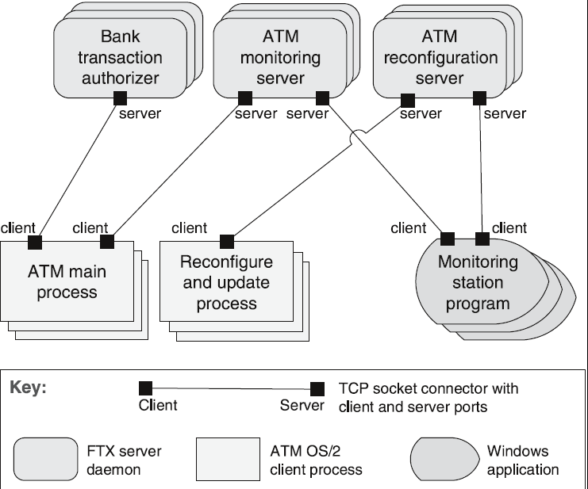
Client-Server Example
ATM Banking System

Slide 62
Client-Server Solution - 1
Overview: Clients initiate interactions with servers, invoking services as needed from those servers and waiting for the results of those requests.
Elements:
  Client, a component that invokes services of a server component. Clients have ports that describe the services they require.
  Server: a component that provides services to clients. Servers have ports that describe the services they provide.
  Request/reply connector: a data connector employing a request/reply protocol, used by a client to invoke services on a server. Important characteristics include whether the calls are local or remote, and whether data is encrypted.

Slide 63
Client-Server Solution- 2
Relations: The attachment relation associates clients with servers.
Constraints:
  Clients are connected to servers through request/reply connectors.
  Server components can be clients to other servers.
Weaknesses:
  Server can be a performance bottleneck.
  Server can be a single point of failure.
  Decisions about where to locate functionality (in the client or in the server) are often complex and costly to change after a system has been built.

Slide 64
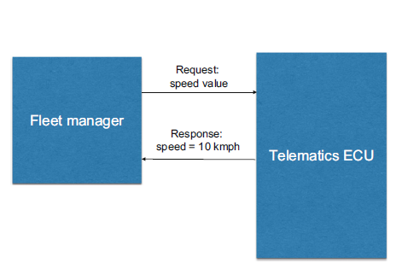
Client Server from Automotive Software Architecture

Slide 65
Publish-Subscribe Pattern
Context: There are a number of independent producers and consumers of data that must interact. The precise number and nature of the data producers and consumers are not predetermined or fixed, nor is the data that they share.
Problem: How can we create integration mechanisms that support the ability to transmit messages among the producers and consumers so they are unaware of each other’s identity, or potentially even their existence?
Solution: In the publish-subscribe pattern, components interact via announced messages, or events. Components may subscribe to a set of events. Publisher components place events on the bus by announcing them; the connector then delivers those events to the subscriber components that have registered an interest in those events.

Slide 66
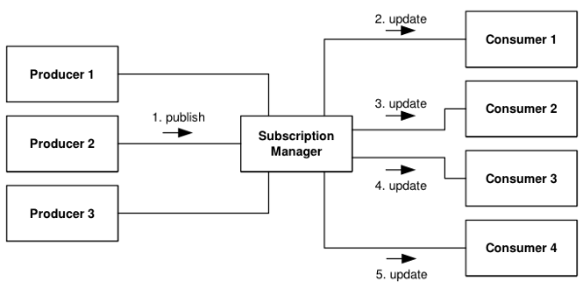
Publish-Subscribe Example
Notes:
Kafka is an example of an event processing system

Slide 67
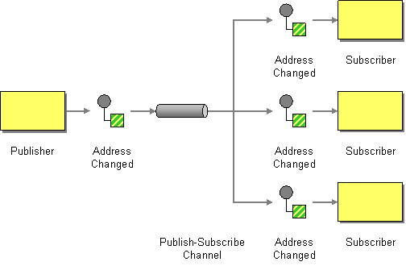
Publish-Subscribe Example
http://www.enterpriseintegrationpatterns.com/patterns/messaging/PublishSubscribeChannel.html

Slide 68
Publish-Subscribe Solution – 1
Overview: Components publish and subscribe to events. When an event is announced by a component, the connector infrastructure dispatches the event to all registered subscribers.
Elements:
  Any C&C component with at least one publish or subscribe port.
  The publish-subscribe connector, which will have announce and listen roles for components that wish to publish and subscribe to events.
Relations: The attachment relation associates components with the publish-subscribe connector by prescribing which components announce events and which components are registered to receive events.

Slide 69
Publish-Subscribe Solution - 2
Constraints: All components are connected to an event distributor that may be viewed as either a bus—connector—or a component. Publish ports are attached to announce roles and subscribe ports are attached to listen roles.
Weaknesses:
  Typically increases latency and has a negative effect on scalability and predictability of message delivery time.
  Less control over ordering of messages, and delivery of messages is not guaranteed.

Slide 70
Broker Pattern
Context: Many systems are constructed from a collection of services distributed across multiple servers. Implementing these systems is complex because you need to worry about how the systems will interoperate—how they will connect to each other and how they will exchange information—as well as the availability of the component services.
Problem: How do we structure distributed software so that service users do not need to know the nature and location of service providers, making it easy to dynamically change the bindings between users and providers?
Solution: The broker pattern separates users of services (clients) from providers of services (servers) by inserting an intermediary, called a broker. When a client needs a service, it queries a broker via a service interface. The broker then forwards the client’s service request to a server, which processes the request.

Slide 71
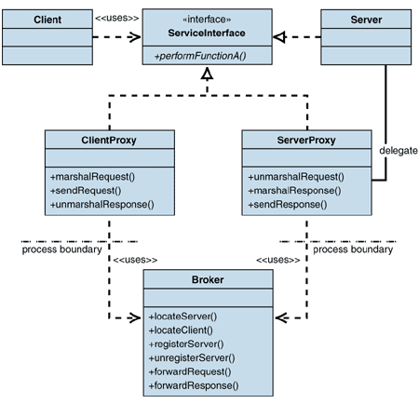
Broker Example

Slide 72
Broker Example

Slide 73
Broker Solution – 1
Overview: The broker pattern defines a runtime component, called a broker, that mediates the communication between a number of clients and servers.
Elements:
  Client, a requester of services
  Server, a provider of services
  Broker, an intermediary that locates an appropriate server to fulfill a client’s request, forwards the request to the server, and returns the results to the client
  Client-side proxy, an intermediary that manages the actual communication with the broker, including marshaling, sending, and unmarshaling of messages
  Server-side proxy, an intermediary that manages the actual communication with the broker, including marshaling, sending, and unmarshaling of messages

Slide 74
Broker Solution - 2
Relations: The attachment relation associates clients (and, optionally, client-side proxies) and servers (and, optionally, server-side proxies) with brokers.
Constraints: The client can only attach to a broker (potentially via a client-side proxy). The server can only attach to a broker (potentially via a server-side proxy).
Weaknesses:
  Brokers add a layer of indirection, and hence latency, between clients and servers, and that layer may be a communication bottleneck.
  The broker can be a single point of failure.
  A broker adds up-front complexity.
  A broker may be a target for security attacks.
  A broker may be difficult to test.

Slide 75
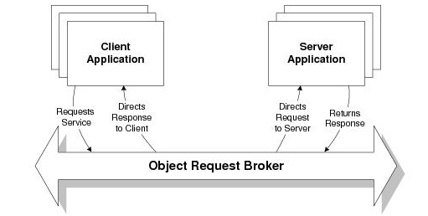
Broker Patterns in the wild
CORBA: Common Object Request Broker Architecture
  Actively developed from 1991 – 2002
Enterprise Java Beans
Microsoft .NET Platform
Apache Kafka
Service Oriented Architectures (covered later) depend on the Broker Pattern
COBRA Programming Model

Slide 76
Pipe and Filter Pattern
Context: Many systems are required to transform streams of discrete data items, from input to output. Many types of transformations occur repeatedly in practice, and so it is desirable to create these as independent, reusable parts.
Problem: Such systems need to be divided into reusable, loosely coupled components with simple, generic interaction mechanisms. In this way they can be flexibly combined with each other. The components, being generic and loosely coupled, are easily reused. The components, being independent, can execute in parallel.
Solution: The pattern of interaction in the pipe-and-filter pattern is characterized by successive transformations of streams of data. Data arrives at a filter’s input port(s), is transformed, and then is passed via its output port(s) through a pipe to the next filter. A single filter can consume data from, or produce data to, one or more ports.

Slide 77
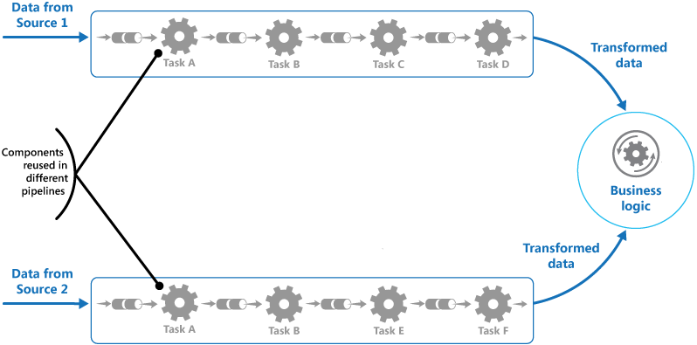
Pipe and Filter Example

Slide 78
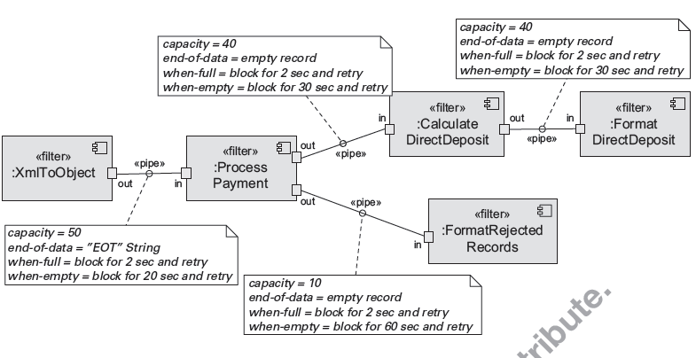
Pipe and Filter Example

Slide 79
Pipe and Filter Solution
Overview: Data is transformed from a system’s external inputs to its external outputs through a series of transformations performed by its filters connected by pipes.
Elements:
  Filter, which is a component that transforms data read on its input port(s) to data written on its output port(s).
  Pipe, which is a connector that conveys data from a filter’s output port(s) to another filter’s input port(s). A pipe has a single source for its input and a single target for its output. A pipe preserves the sequence of data items, and it does not alter the data passing through.
Relations: The attachment relation associates the output of filters with the input of pipes and vice versa.
Constraints:
  Pipes connect filter output ports to filter input ports.
  Connected filters must agree on the type of data being passed along the connecting pipe.

Slide 80
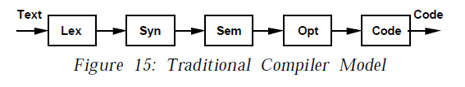
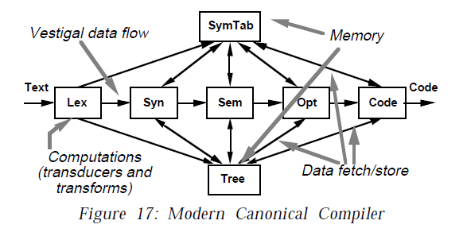
Pipeline Architecture Examples
Garlan, David, and Mary Shaw. “AN INTRODUCTION TO SOFTWARE ARCHITECTURE.”

Slide 81
Blackboard Pattern
Context - An immature or poorly specified domain with no deterministic or optimal solution known for the problem. Hence, software systems that need to integrate large and diverse specialized modules, and implement complex, nondeterministic control strategies. E.g., speech recognition, other AI “expert” applications. Metaphor of humans collaborating with a blackboard.
Problem –The problem spans several fields of expertise that require a sequence of independent algorithmic transformations. Intermediate solutions require different representations. Algorithm experimentation may be required. The control strategy is complex and cannot be determined statically.
Solution - a collection of independent specialized programs work cooperatively utilizing a common data structure. A central controller coordinates the knowledge sources based on the state of the solution.

Slide 82
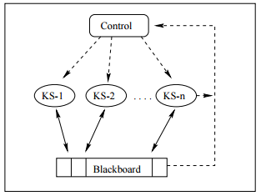
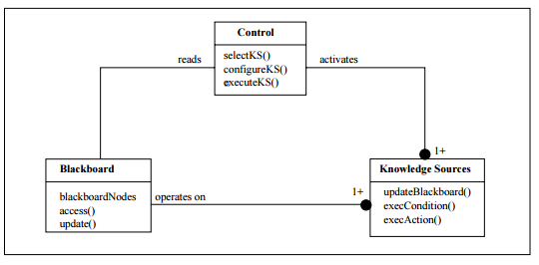
Blackboard Example

Slide 83
Blackboard Solution - 1
Overview - Problem solvers work independently (and opportunistically) on parts of the problem. They share a common data structure (the blackboard). A central controller manages access to the blackboard. The blackboard may be structured (e.g. into levels of abstraction) so problem solvers may work at different levels. Blackboard contains original input and/or partial solutions
Elements
  Knowledge source - separate, independent subsystems that solve specific aspects of the overall problem
  Blackboard - the central data store for solution space and control data It provides an interface to enable knowledge source access
  Control – uses data in the blackboard to coordinate the sequence interaction between knowledge sources

Slide 84
Blackboard Solution – 2
Relations – knowledge sources are completely independent. They are coordinated by the state of data in the blackboard and control directed actuation.
Constraints – computationally expensive, low support for parallelism, no good solution is guaranteed, control solution may be heuristic
Weaknesses - Difficulty of testing, may be hard to develop

Slide 85
Integrability
Reducing The costs and Technical risks of anticipated and unanticipated future integration tasks

Slide 86
Points to Consider
  Components may be coupled temporally or through resources – they share and compete for finite resources
  Components may be semantically linked – they share knowledge of the same protocol, file format, metadata, unit of measure, etc.
  Distance can be a good tool for measuring the dependencies between components
    Syntactic Distance – agreement on the number and type of data elements being shared
    Data Semantic Distance – agreement on data semantics, values are interpreted the same
    Behavioral Semantic Distance – agreement on behavior, especially the states and modes of the system
    Temporal Distance – agreement on assumptions about time
    Resource Distance – agreement on the assumptions about shared resources

Slide 87
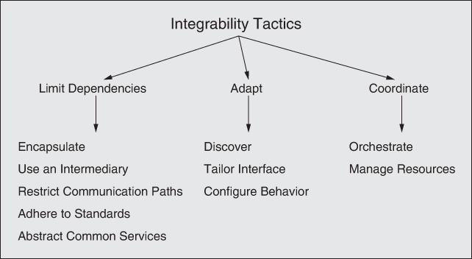
Integrability Tactics

Slide 88
Limit Dependencies
Encapsulate: Introduce an explicit interface to isolate an element
Use an Intermediary: Break dependencies between components
Restrict Communication Paths: Restrict the elements that a component can communicate with
Adhere to Standards:
Abstract Common Services: Generalize and specialize

Slide 89
Adapt
Discover: Use a mechanism for applications to find services
Tailor Interfaces: Add or remove capabilities to an interface without changing it – buffering, translation, etc.
Configure Behavior: Exact behavior can be assigned at compile time or runtime using flags or config files. Support evolving interfaces, etc.

Slide 90
Coordinate
Orchestrate: Use a control mechanism to coordinate and manage the innovation of services
Manage Resources: An intermediary that governs access to computing resources

Slide 91
Patterns
Wrappers – a form of encapsulation where some component is encapsulated in an alternate wrapper
Bridges – translate from one component to another
Mediators – a cross between a wrapper and a bridge that adds runtime determination of the translation
Service Oriented Architecture – a collection of distributed components that provide and/or consume services
Dynamic Discovery – application of the discovery tactic to enable finding service providers at runtime

Slide 92
Service Oriented Architecture Pattern
Context: A number of services are offered (and described) by service providers and consumed by service consumers. Service consumers need to be able to understand and use these services without any detailed knowledge of their implementation.
Problem: How can we support interoperability of distributed components running on different platforms and written in different implementation languages, provided by different organizations, and distributed across the Internet?
Solution: The service-oriented architecture (SOA) pattern describes a collection of distributed components that provide and/or consume services.

Slide 93
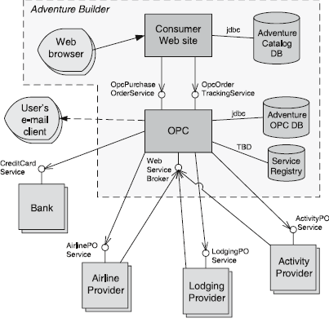
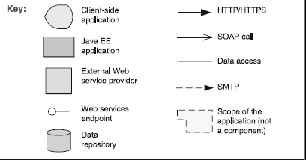
Service Oriented Architecture Example
“Adventure Builder”
OPC – Order Processing Center

Slide 94
Service Oriented Architecture Solution - 1
Overview: Computation is achieved by a set of cooperating components that provide and/or consume services over a network.
Elements:
  Components:
    Service providers, which provide one or more services through published interfaces.
    Service consumers, which invoke services directly or through an intermediary.
    Service providers may also be service consumers.
  Enterprise Service Bus (ESB), which is an intermediary element that can route and transform messages between service providers and consumers.
  Registry of services, which may be used by providers to register their services and by consumers to discover services at runtime.
  Orchestration server, which coordinates the interactions between service consumers and providers based on languages for business processes and workflows.

Slide 95
Service Oriented Architecture Solution - 2
  Connectors:
    SOAP connector, which uses the SOAP protocol for synchronous communication between web services, typically over HTTP.
    REST connector, which relies on the basic request/reply operations of the HTTP protocol.
    Asynchronous messaging connector, which uses a messaging system to offer point-to-point or publish-subscribe asynchronous message exchanges.

Slide 96
Service Oriented Architecture Solution - 3
Relations: Attachment of the different kinds of components available to the respective connectors
Constraints: Service consumers are connected to service providers, but intermediary components (e.g., ESB, registry, orchestration server) may be used.
Weaknesses:
  SOA-based systems are typically complex to build.
  You don’t control the evolution of independent services.
  There is a performance overhead associated with the middleware, and services may be performance bottlenecks, and typically do not provide performance guarantees.

Slide 97
Performance
It’s about time and the software system’s ability to meet timing requirements

Slide 98
Points to Consider
  When events occur the system must respond to them in time
    Interrupt
    Messages
    Requests from users
    Requests from other systems
    Clock events
  All systems have performance requirements
    They may be explicit or implied
  Performance is linked to scalability
  Processing time and resource usage
  Blocked time and resource contention

Slide 99
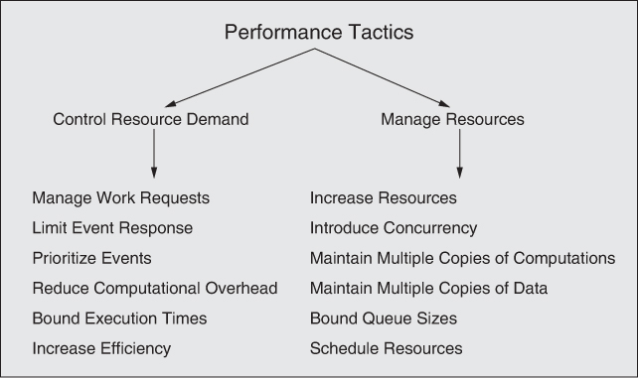
Performance Tactics

Slide 100
Control Resource Demand
Manage Work Requests: Reduce the number of requests coming into the system
Limit Event Response: Cap the number of events processed, policies for ignoring events
Prioritize Events: Ensure important events are processed rapidly
Reduce Computational Overhead: Colocation, reduce intermediaries
Bound Execution Times: Limit the amount of time spent processing an event
Increase Efficiency of Resource Usage: Improve algorithms, logic

Slide 101
Manage Resources
Increase Resources
Introduce Concurrency
Maintain Multiple Copies of Computations: Replicate services
Maintain Multiple Copies of Data: Replicate data, use caching
Bound Queue Sizes: Limit the number of arrivals (and have a strategy when too many arrive)
Schedule Resources

Slide 102
Patterns
Service Mesh: Split core functionality from services such as authentication, authorization, discovery, etc.
Load Balancer: An intermediary that handles messages originating from some set of clients and determines which instance of a service should respond
Throttling: Packaging of the manage work-request tactic. Limits access to an important resource
Map-Reduce: Distributed and parallel sort of large data sets
Peer to Peer: Distributed computational entities need to cooperate and collaborate to provide a service to a distributed community of users
Event Driven: Handle incoming independent asynchronous application generated events in a manner that can scale up as demand increase
Shared Data: Computational components need to share and manipulate large amounts of data

Slide 103
Map-Reduce Pattern
Context: Businesses have a pressing need to quickly analyze enormous volumes of data they generate or access, at petabyte scale.
Problem: For many applications with ultra-large data sets, sorting the data and then analyzing the grouped data is sufficient. The problem the map-reduce pattern solves is to efficiently perform a distributed and parallel sort of a large data set and provide a simple means for the programmer to specify the analysis to be done.
Solution: The map-reduce pattern requires three parts:
  A specialized infrastructure takes care of allocating software to the hardware nodes in a massively parallel computing environment and handles sorting the data as needed.
  A programmer specified component called the map which filters the data to retrieve those items to be combined.
  A programmer specified component called reduce which combines the results of the map

Slide 104
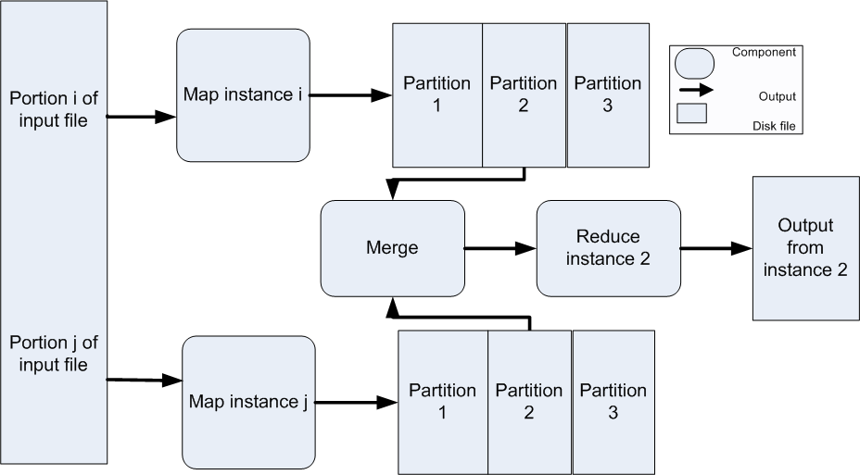
Map-Reduce Example

Slide 105
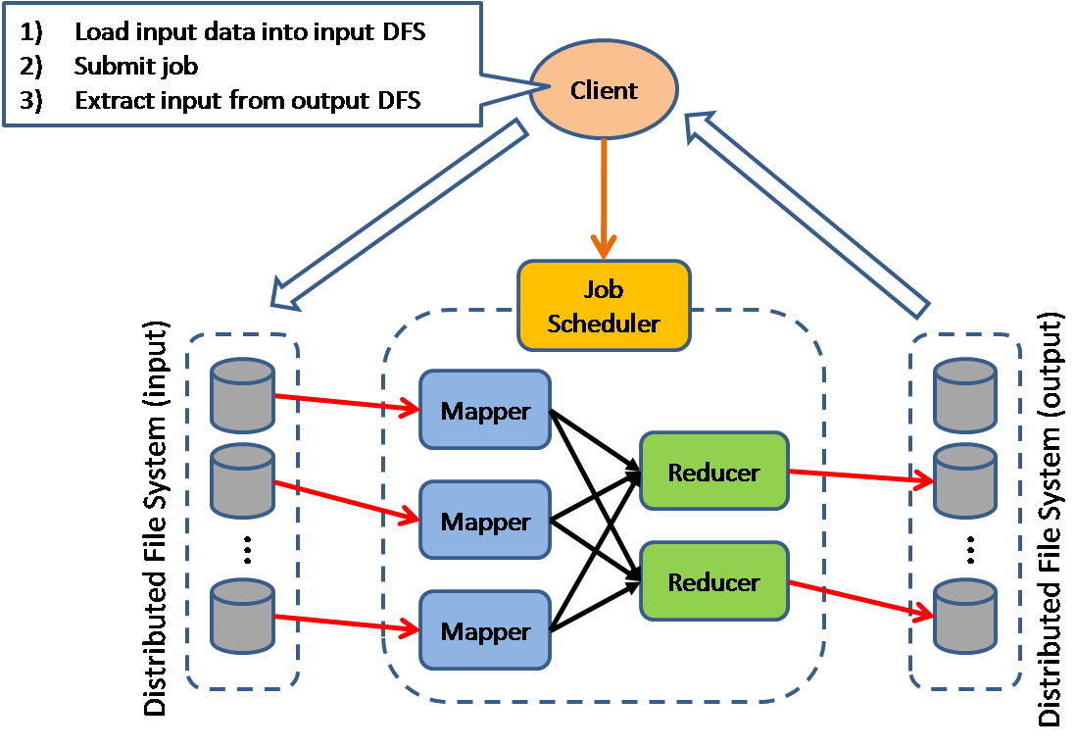
Another Map-Reduce View

Slide 106
Map-Reduce Solution - 1
Overview: The map-reduce pattern provides a framework for analyzing a large distributed set of data that will execute in parallel, on a set of processors. This parallelization allows for low latency and high availability. The map performs the extract and transform portions of the analysis and the reduce performs the loading of the results.
Elements:
  Map is a function with multiple instances deployed across multiple processors that performs the extract and transformation portions of the analysis.
  Reduce is a function that may be deployed as a single instance or as multiple instances across processors to perform the load portion of extract-transform-load.
  The infrastructure is the framework responsible for deploying map and reduce instances, shepherding the data between them, and detecting and recovering from failure.

Slide 107
Map-Reduce Solution - 2
Relations:
  Deploy on is the relation between an instance of a map or reduce function and the processor onto which it is installed.
  Instantiate, monitor, and control is the relation between the infrastructure and the instances of map and reduce.
Constraints:
  The data to be analyzed must exist as a set of files.
  Map functions are stateless and do not communicate with each other.
  The only communication between map reduce instances is the data emitted from the map instances as <key, value> pairs.
Weaknesses:
  If you do not have large data sets, the overhead of map-reduce is not justified.
  If you cannot divide your data set into similar sized subsets, the advantages of parallelism are lost.
  Operations that require multiple reduces are complex to orchestrate.

Slide 108
Peer-to-Peer Pattern
Context: Distributed computational entities—each of which is considered equally important in terms of initiating an interaction and each of which provides its own resources—need to cooperate and collaborate to provide a service to a distributed community of users.
Problem: How can a set of “equal” distributed computational entities be connected to each other via a common protocol so that they can organize and share their services with high availability and scalability?
Solution: In the peer-to-peer (P2P) pattern, components directly interact as peers. All peers are “equal” and no peer or group of peers can be critical for the health of the system. Peer-to-peer communication is typically a request/reply interaction without the asymmetry found in the client-server pattern.

Slide 109
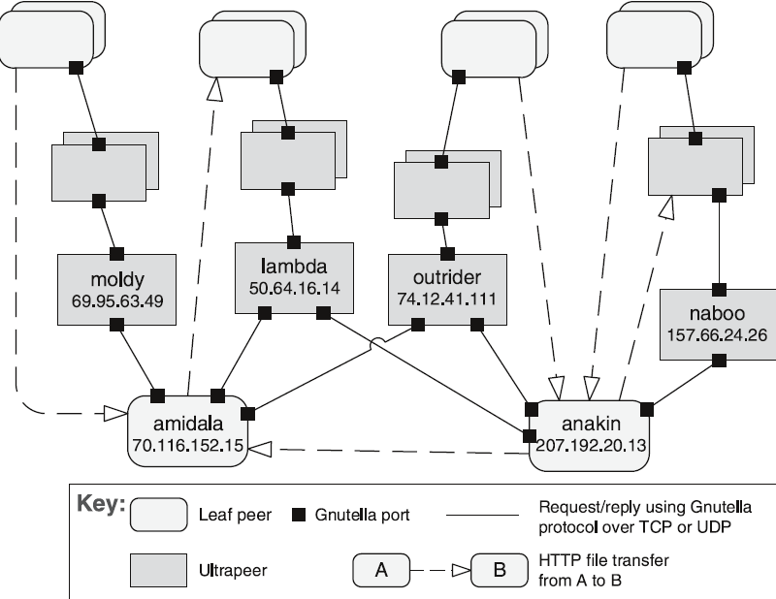
Peer-to-Peer Example
Gnutella Network

Slide 110
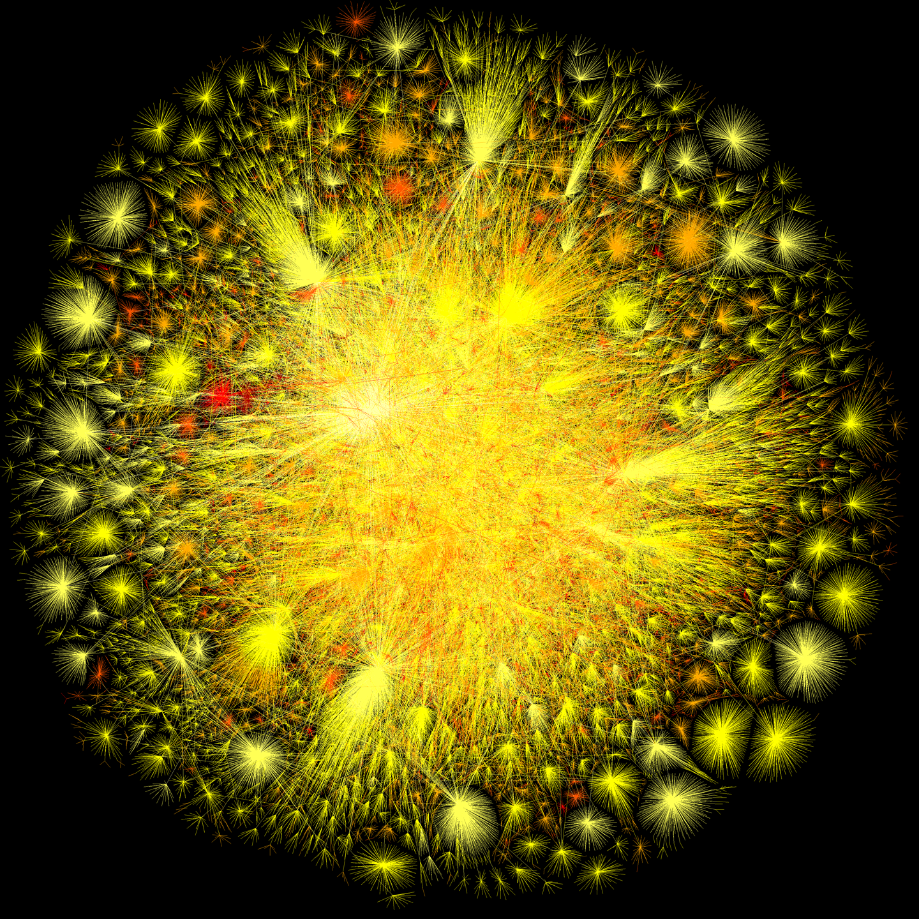
The Internet in 2010
The color selection is based on the color of incandescence, where the most connection points represent the highest temperatures in terms of colors of light.
http://videobot.ash1.opte.org/content/opte/maps/static/opte-2010.png

Slide 111
Peer-to-Peer Solution - 1
Overview: Computation is achieved by cooperating peers that request service from and provide services to one another across a network.
Elements:
  Peer, which is an independent component running on a network node. Special peer components can provide routing, indexing, and peer search capability.
  Request/reply connector, which is used to connect to the peer network, search for other peers, and invoke services from other peers. In some cases, the need for a reply is done away with.
Relations: The relation associates peers with their connectors. Attachments may change at runtime.

Slide 112
Peer-to-Peer Solution - 2
Constraints:
  Restrictions may be placed on the following:
    The number of allowable attachments to any given peer
    The number of hops used for searching for a peer
    Which peers know about which other peers
    Some P2P networks are organized with star topologies, in which peers only connect to supernodes.
Weaknesses:
  Managing security, data consistency, data/service availability, backup, and recovery are all more complex.
  Small peer-to-peer systems may not be able to consistently achieve quality goals such as performance and availability.

Slide 113
Event Driven Architecture
Context – computational and information resources need to be provided to handle incoming independent asynchronous application generated events in a manner that can scale up as demand increases.
Problem – construct distributed systems that can service asynchronous arriving messages associate with an event, and that can scale from small and simple to large and complex.
Solution – deploy independent event processes/processors for event handling. Arriving events are queued. A scheduler pulls events from the queue and distributes them to the appropriate event handler based on a scheduling policy.
Software Architecture Patterns, Mark Richards

Slide 114
Event Driven Architecture Example
Mediator topology – orchestrate multiple steps to handle an event according to some application policy
Broker topology – distribute messages in a simple chained message flow
Software Architecture Patterns, Mark Richards

Slide 115
Event Driven Architecture Pattern Solution
Overview – arriving client generated requests for service arrive as events. They are queued, and then directed to an appropriate event handler according to some application policy. This pattern can be used in a wide range of applications.
Elements – the event queue, the scheduler, and the collection of pertinent event handlers. Event handlers may be deployed as independent processes and/or processors.
Relationships – clients and event handlers are usually distributed on a network but do not have to be. Message communication protocols and message formats should be consistent and standards based
Constraints – there is no built-in transactional support. The inherent complexity of deploying distributed systems.
Weaknesses – performance and error recovery may be issues. On the plus side, with low coupling the resulting systems are highly scalable.
Software Architecture Patterns, Mark Richards

Slide 116
Shared-Data Pattern
Context: Various computational components need to share and manipulate large amounts of data. This data does not belong solely to any one of those components.
Problem: How can systems store and manipulate persistent data that is accessed by multiple independent components?
Solution: In the shared-data pattern, interaction is dominated by the exchange of persistent data between multiple data accessors and at least one shared-data store. Exchange may be initiated by the accessors or the data store. The connector type is data reading and writing.

Slide 117
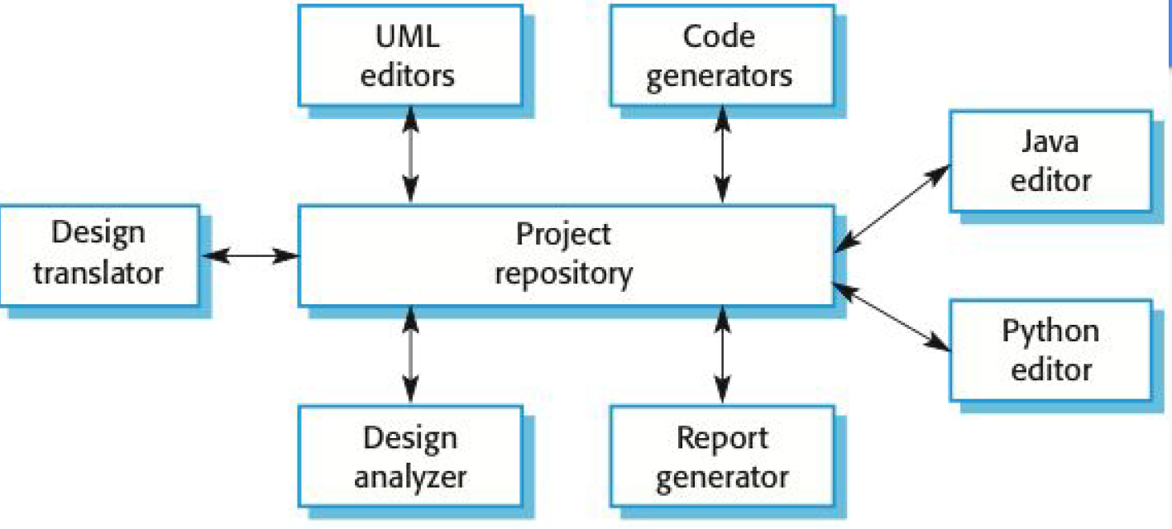
Shared Data Example

Slide 118
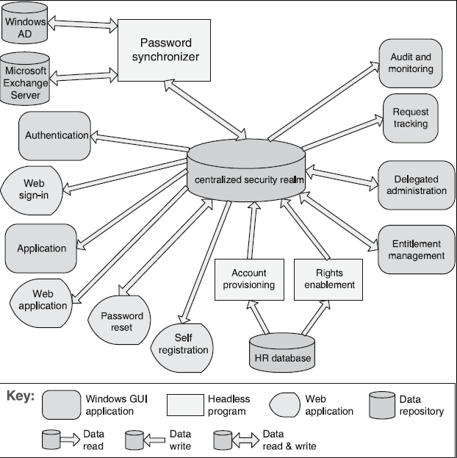
Shared Data Example
Enterprise Access Management System

Slide 119
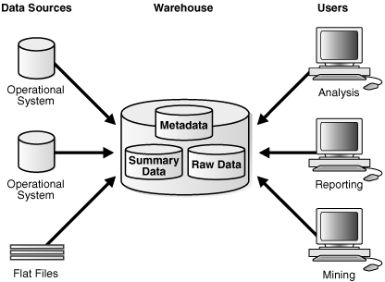
Data Warehouse Example
Oracle – Introduction to Data Warehousing Concepts

Slide 120
Shared Data Solution - 1
Overview: Communication between data accessors is mediated by a shared data store. Control may be initiated by the data accessors or the data store. Data is made persistent by the data store.
Elements:
  Shared-data store. Concerns include types of data stored, data performance-oriented properties, data distribution, and number of accessors permitted.
  Data accessor component.
  Data reading and writing connector.

Slide 121
Shared Data Solution - 2
Relations: Attachment relation determines which data accessors are connected to which data stores.
Constraints: Data accessors interact only with the data store(s).
Weaknesses:
  The shared-data store may be a performance bottleneck.
  The shared-data store may be a single point of failure.
  Producers and consumers of data may be tightly coupled.

Slide 122
Usability
How easy is it for the user to complete a desired task

Slide 123
Points to Consider
Usability consists of:
  Learning System Features
  Using a System Efficiently
  Minimizing the Impact of User Errors
  Adapting the System to the User’s Needs
  Increasing Confidence and Satisfaction

Slide 124
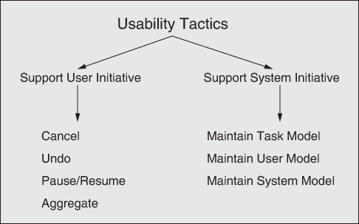
Usability Tactics

Slide 125
Support User Initiative
Cancel: When the user issues a cancel, the system must be listening for it and the activity must be terminated
Undo: The system must maintain a sufficient amount of information about state so previous state(s) can be restored
Pause / Resume: It is often useful to be able to pause long running activities to allow resources to be temporarily reallocated to other tasks
Aggregate: Group low-level operations into a single step

Slide 126
Support System Initiatives
Maintain Task Model: The task model is used to determine context so the system can have some idea of the user’s intentions
Maintain User Model: Represent the user’s knowledge of the system – user interface customization can be part of this
Maintain System Model: The system maintains an explicit model of itself and how long activities should take to allow accurate user feedback

Slide 127
Patterns
Model-View-Controller: Separates application functionality into a model, which contains the application’s data; a view, which displays the data and interacts with the user; and a controller, which mediates between the model and the view
Observer: Link functionality with one or more views
Memento – Snapshot a state for undo

Slide 128
Model-View-Controller Pattern
Context: User interface software is typically the most frequently modified portion of an interactive application. Users often wish to look at data from different perspectives, such as a bar graph or a pie chart. These representations should both reflect the current state of the data.
Problem: How can user interface functionality be kept separate from application functionality and yet still be responsive to user input, or to changes in the underlying application’s data? And how can multiple views of the user interface be created, maintained, and coordinated when the underlying application data changes?
Solution: The model-view-controller (MVC) pattern separates application functionality into three kinds of components:
  A model, which contains the application’s data
  A view, which displays some portion of the underlying data and interacts with the user
  A controller, which mediates between the model and the view and manages the notifications of state changes

Slide 129
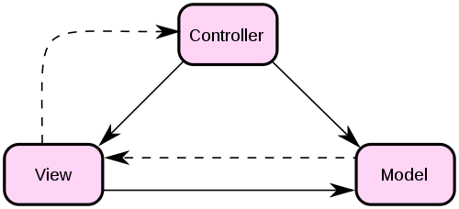
MVC Example
Manage user requests
Initiates model behavior
Select view response
User events
View selection
State Change
Change notification
State query
Receives model data
Requests model data
Presents view
Encapsulates application
functions and data
Invocations
Events

Slide 130
MVC Solution - 1
Overview: The MVC pattern breaks system functionality into three components: a model, a view, and a controller that mediates between the model and the view.
Elements:
  The model is a representation of the application data or state, and it contains (or provides an interface to) application logic.
  The view is a user interface component that either produces a representation of the model for the user or allows for some form of user input, or both.
  The controller manages the interaction between the model and the view, translating user actions into changes to the model or changes to the view.

Slide 131
MVC Solution - 2
Relations: The notifies relation connects instances of model, view, and controller, notifying elements of relevant state changes.
Constraints:
  There must be at least one instance each of model, view, and controller.
  The model component should not interact directly with the controller.
Weaknesses:
  The complexity may not be worth it for simple user interfaces.
  The model, view, and controller abstractions may not be good fits for some user interface toolkits.

Slide 132
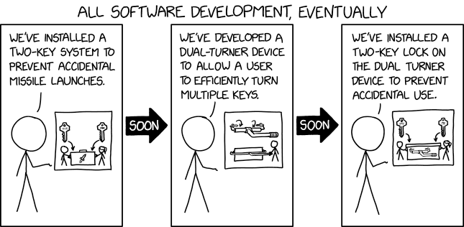
Safety
The system’s ability to avoid straying into states that cause or lead to damage, injury or loss of life

Slide 133
Points to Consider
  Unsafe states can be caused by a number of factors:
    Omissions
    Commission – the spurious occurrence of an undesirable event
    Timing
    Problems with System values
    Sequence omission and commission – in a sequence of events an event is missing or an unexpected event is inserted
    Out of sequence
  Architecting for safety begins by identifying the system’s safety critical functions
    FMEA – Failure Mode and Effects Analysis
    FTA – Fault Tree Analysis

Slide 134
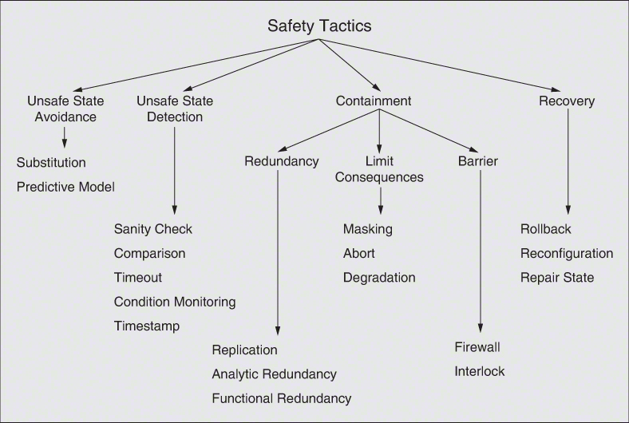
Safety Tactics

Slide 135
Security

Slide 136
Points to Consider
CIA
  Confidentiality – Data or services are protected from unauthorized access
  Integrity – The data or services are not subject to unauthorized manipulation
  Availability – The system will be available for legitimate usage
  Privacy – related to security. Achieving privacy is about limiting access to information

Slide 137
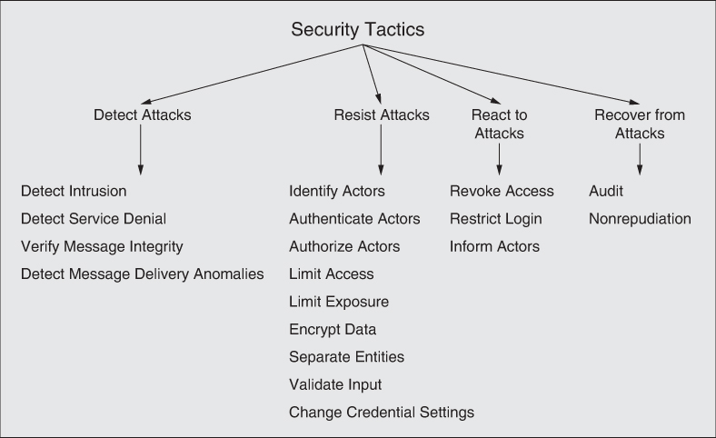
Security Tactics

Slide 138
Detect Attacks
Detect Intrusion – Detect patterns associated with malicious behavior
Detect Service Denial – Detect patterns associated with Denial of Service Attacks
Verify Message Integrity – Use techniques like hash codes or checksums to validate message integrity
Detect Message Delivery Anomalies – Detect man in the middle style attacks by examining message delivery times

Slide 139
Resist Attacks
Identify Actors – identify source of any external input to the system
Authenticate Actors – Verify that actors are who they claim to be
Authorize Actors – Ensure actors have the correct role and privileges to perform an operation
Limit Access – Limit access to resources / DMZ
Limit Exposure – Minimize amount of data exposed through any one access point
Encrypt Data – encrypt data at rest and data crossing a communication channel
Separate Entities – physical or virtual separation of services and servers
Validate Input – clean and check data as it is received, SQL Injection, etc.
Change Credential Settings – periodically change settings

Slide 140
React to Attacks
Revoke Access – limit access to sensitive resources
Restrict Login – Lockout time after multiple failed logins, black list
Inform Actors – Notify relevant actors when an attack is detected

Slide 141
Recover from Attacks
Audit – Keep audit records and analyze them to determine what went wrong and why
Nonrepudiation – Use signatures and authentication to validate participants in an interaction

Slide 142
Testability

Slide 143
Points to Consider
  What architectural decisions can we make to enable testing?
  An architecture can enhance testability by making it easier to replicate a bug and to narrow down the root causes
  How can we control a components inputs?
  Set state?
  Observe outputs?

Slide 144
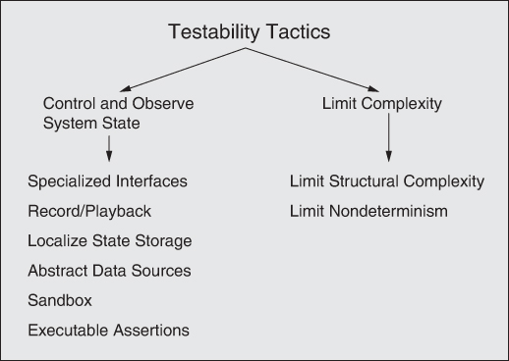
Testability Tactics

Slide 145
Control and Observe System State
Specialized Interfaces: Provide the ability to capture and control state both while running in a test harness or production environment
  Setters and Getters, Report Method, Reset Method, Logging Levels
Record/Playback: Record the state of the system when it crosses an interface and using this information to recreate and replay an event
Localize State Storage: Design to allow components to be self-contained allowing easier isolation for replay and debugging
Abstract Data Sources: Provide a means of easily providing test data
Sandbox: Leverage test environments, virtualization

Slide 146
Limit Complexity
Limit Structural Complexity: High cohesion / low coupling
  Reduce intermodule dependencies
Limit Nondeterminism: Limit behavioral complexity

Slide 147
Patterns
Dependency Injection Pattern: Separate a client’s dependencies form its behavior.
Strategy Pattern: Provide the ability to choose the algorithm at runtime, the ability to switch between a test version with more logging functionality
Intercepting Filter Pattern: The ability to add pre or post processing filters to a request

Slide 148
Addendum

Slide 149
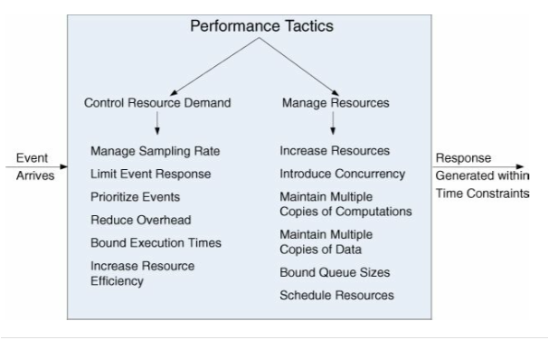
Performance Tactics

Slide 150
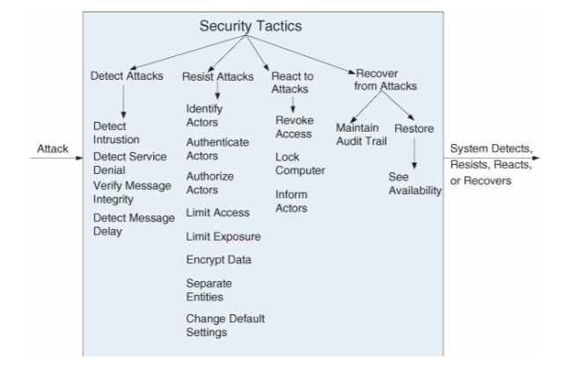
Security Tactics

Slide 151
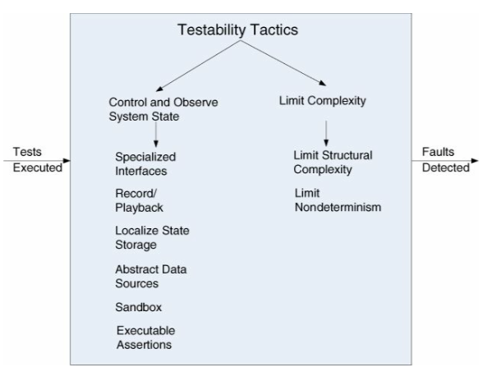
Testability Tactics

Slide 152
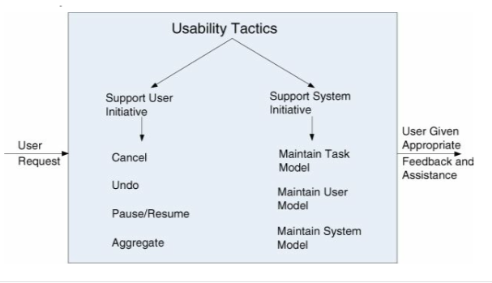
Usability Tactics

Slide 153
1
Response
Measure
Source
Artifact
3
6
Stimulus
Response
2
Environment
5
4

Slide 154
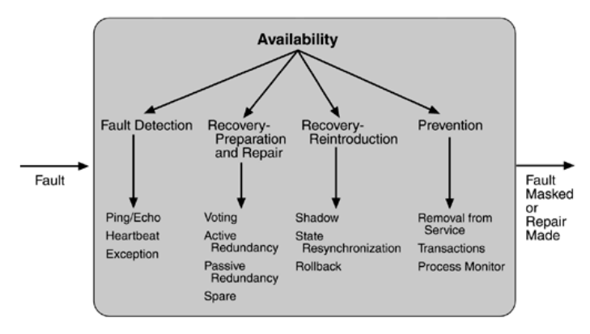
Example – Tactics for Availability
Fault Detection

Slide 155

Modifiability Tactics
Paper on Modifiability Tactics:
https://resources.sei.cmu.edu/library/asset-view.cfm?assetid=8299

Slide 156
Safety Tactics
Unsafe State Avoidance
Unsafe State Detection
Containment
Substitution
Predictive Model
Sanity Check
Comparison
Timeout
Condition Monitoring
Timestamp
Redundancy
Limit Consequences
Barrier
Recovery
Rollback
Reconfiguration
Repair State
Firewall
Interlock
Masking
Abort
Degradation
Replication
Analytic Redundancy
Function Redundancy

Slide 157
Integrability Tactics
Limit Dependencies
Adapt
Coordinate
Orchestrate
Manage Resources
Discover
Tailor Interface
Configure Behavior
Encapsulate
Use an Intermediary
Restrict Communication Paths
Adhere to Standards
Abstract Common Services

Slide 158
Deployability Tactics
Manage Deployment Pipeline
Manage Deployed System
Scale Rollouts
Script Deployment Commands
Rollback
Manage Service Interactions
Package Dependencies
Toggle Features

Slide 159
Performance Tactics
Control Resource Demand
Manage Resources
Manage Work Requests
Increase Resources
Introduce Concurrency
Maintain Multiple Copies of Computations
Maintain Multiple Copies of Data
Bound Queue Size
Schedule Resources
Limit Event Response
Prioritize Events
Reduce Computational Overhead
Bound Execution Times
Increase Efficiency

Slide 160
Performance Tactics
Control Resource Demand
Manage Resources
Manage Work Requests
Increase Resources
Introduce Concurrency
Maintain Multiple Copies of Computations
Maintain Multiple Copies of Data
Bound Queue Size
Schedule Resources
Limit Event Response
Prioritize Events
Reduce Computational Overhead
Bound Execution Times
Increase Efficiency

Slide 161
Security Tactics
Detect Attacks
Resist Attacks
Detect Intrusion
Identify Actors
Detect Service Denial
Verify Message Integrity
Detect Message Delivery Anomalies
Authenticate Actors
Authorize Actors
Limit Access
Limit Exposure
Encrypt Data
Separate Entities
Validate Input
Change Credential Settings
React to Attacks
Revoke Access
Restrict Login
Inform Actors
Recover from Attacks
Audit
Nonrepudiation

Slide 162
Energy Efficiency Tactics
Monitor Resources
Allocate Resources
Metering
Reduce Usage
Discovery
Static Classification
Dynamic Classification
Schedule Resources
Reduce Resource Demand
Manage Event Arrival
Limit Event Response
Prioritize Events
Reduce Computational Overhead
Bound Execution Times
Increase Resource Usage Efficiency

Slide 163
Testability Tactics
Control and Observe System State
Limit Complexity
Specialized Interfaces
Limit Structural Complexity
Limit Nondeterminism
Record/playback
Localize State Storage
Abstract Data Sources
Sandbox
Executable Assertions

Slide 164
Usability Tactics
Support User Initiative
Support System Initiative
Cancel
Undo
Pause / Resume
Aggregate
Maintain Task Model
Maintain User Model
Maintain System Model

Slide 165
Modifiability Tactics
Increase Cohesion
Reduce Coupling
Split Module
Encapsulate
Redistribute Responsibilities
Use an Intermediary
Abstract Common Services
Restrict Dependencies
Defer Binding
Component Replacement
Couple-time Parameterization
Aspects
Configuration Time Binding
Resource Files
Discovery
Interpret Parameters
Shared Repositories
Polymorphism

